Slide 1
Flow Control, Reliable Transmission
Reference: William Stallings, “Data and Computer Communications”, 6th edition, Prentice Hall, 2000.
EE4204/TEE4204 (Part 1) Notes 4
G. Mohan/ NUS

Slide 2
What is Flow Control?
Consider a link connecting sender and receiver nodes
  If sender is faster and receiver is slower in processing frames then we say sender jams receiver. This leads to buffer overflow at the receiver
Flow control is a technique used to ensure that a sender does not overwhelm (jam) the receiver
Usually, receiver allocates a buffer of some size for frame transfer
Flow control prevents buffer overflow at the receiver
Flow control concerns with two end nodes: sender and receiver, SHOULD NOT be confused with congestion control
Flow control is used at the connection level between end nodes at Layer-4 and link-level (could be optional) at Layer-2
EE4204/TEE4204 (Part 1) Notes 4
G. Mohan/ NUS

Slide 3
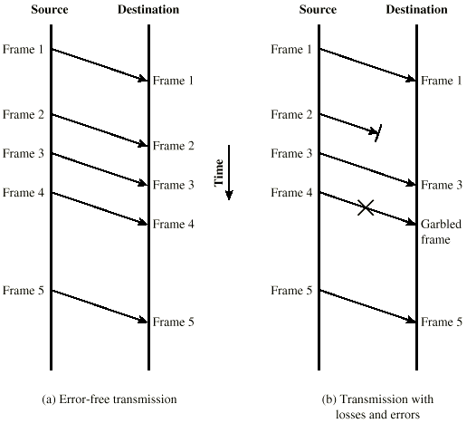
Model of Frame Transmission
EE4204/TEE4204 (Part 1) Notes 4
G. Mohan/ NUS

Slide 4
Stop and Wait
Source transmits a frame
Destination receives a frame and replies with an acknowledgement (ACK)
Source waits for ACK before sending the next frame
Destination can stop flow by not sending ACK
Simple implementation
EE4204/TEE4204 (Part 1) Notes 4
G. Mohan/ NUS

Slide 5
Fragmentation
Large block of data may be split into small frames for the following reasons
  Limited buffer size
  Errors detected sooner (when whole frame received)
  On error, retransmission frames are small
  Prevents one station occupying medium for long periods (broadcast network)
Stop and wait becomes inadequate when a large number of frames are sent
EE4204/TEE4204 (Part 1) Notes 4
G. Mohan/ NUS

Slide 6
Sliding Windows Flow Control
Allow multiple frames to be in transit to improve link utilization
Receiver has buffer of length W
Transmitter can send up to W frames without waiting for ACK
Each frame is numbered (called sequence numbers)
ACK includes the sequence number of next frame expected
ACK n (or) RR n (receiver ready) indicates that the receiver has received frames numbered up through n-1 and is ready to receive frame n onwards (cumulative acknowledgement)
Sequence number bounded by size of field (k)
  K-bit sequence number in frame header
  Frames are numbered modulo 2^{k} ( 0 through 2^{k} )
  For K=3, frames are numbered 0,1,2,3,,4,5,6,7,0,1,…6,7,0…
EE4204/TEE4204 (Part 1) Notes 4
G. Mohan/ NUS

Slide 7
Sliding Window Flow Control (contd.)
Sender
  Keeps a window of (max) size W
  Initially window size is W
  Window size indicates the maximum number of frames that could be transmitted without need to wait for any acknowledgement
  When a frame is sent, window shrinks by one
  When an ACK is received, window expands by one
  Keeps the frames in buffer that are not yet acknowledged (Why?)
EE4204/TEE4204 (Part 1) Notes 4
G. Mohan/ NUS

Slide 8
Sliding Window Flow Control (contd.)
Receiver
  Keeps a window of (max) size W
  Initially window size is W
  Window size indicates the maximum number of frames that could be received (without need to send any acknowledgement)
  When a frame is received, window shrinks by one
  When an ACK is sent window expands by one
  Keeps in buffer, the frames received but ACKs have not yet been sent (Why?)
EE4204/TEE4204 (Part 1) Notes 4
G. Mohan/ NUS

Slide 9
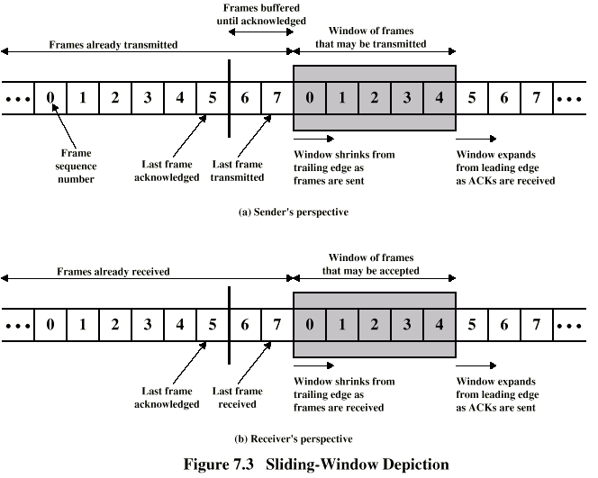
Sliding Window Illustration
EE4204/TEE4204 (Part 1) Notes 4
G. Mohan/ NUS

Slide 10
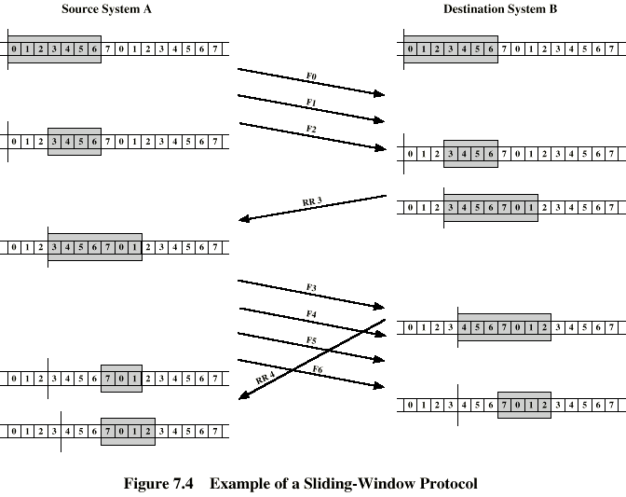
Example Sliding Window
EE4204/TEE4204 (Part 1) Notes 4
G. Mohan/ NUS

Slide 11
Sliding Window Enhancements
Receiver can acknowledge frames without permitting further transmission (Receive Not Ready)
  Must send a normal acknowledgement to resume
If duplex, use piggybacking
  Two-way communication between nodes
  A node can be a sender for some data and receiver for some data
  Receiver sends ACK (RR) as a part of data frame to the other node
    ACK no is specified as a part of header
    A sends its data frame F3 to B. B receives F3.
    B sends its data frame F6 which carries ACK 4 (specifies 4 in ACK field of header)
  Receiver has no data frame to send
    use a separate acknowledgement frame
  Receiver has data frame but no acknowledgement to send,
    send last acknowledgement number again
EE4204/TEE4204 (Part 1) Notes 4
G. Mohan/ NUS

Slide 12
Error Control and Reliable Transmission
Detection and correction of errors
Lost frames
  Noise burst affects the frame to the extent that the frame is not recognizable by the receiver
Damaged frames
  Receiver can recognize the frame but some bits are in error
  If the receiver is not sure about frame sequence number, then damaged frame requires the same treatment as lost frame
Automatic repeat request (ARQ)
  Error detection
  Positive acknowledgment (ACK, RR)
  Retransmission after timeout
  Negative acknowledgement and retransmission (NACK, REJ (reject) SREJ (selective reject))
EE4204/TEE4204 (Part 1) Notes 4
G. Mohan/ NUS

Slide 13
Automatic Repeat Request (ARQ)
Stop-and-Wait ARQ
Go-Back-N ARQ
  based on sliding window control
  Max window size is 2^{k}-1 where k is the seq-no field.
Selective-Reject (selective retransmission) ARQ
  based on sliding window control
  Max window size is 2^{k-1} where k is the seq-no field.
Go-Back-N is widely used when compared to Selective-Reject
Typical window size
  7 for LANs (low speed link, short distance)
  127 for WANs (high speed link, long distance), WHY?
EE4204/TEE4204 (Part 1) Notes 4
G. Mohan/ NUS

Slide 14
Stop and Wait ARQ
Sender transmits a frame
When a frame arrives, receiver sends ACK
Sender waits for ACK before transmitting the next frame
If received frame damaged/lost, receiver discards it
  Transmitter uses TIMEOUT mechanism
  If no ACK within timeout, retransmit
If ACK damaged/lost, transmitter will not recognize it
  Transmitter will retransmit
  Receiver gets two copies of the same frame
  Alternate between ACK0 and ACK1 to solve the above problem
EE4204/TEE4204 (Part 1) Notes 4
G. Mohan/ NUS

Slide 15
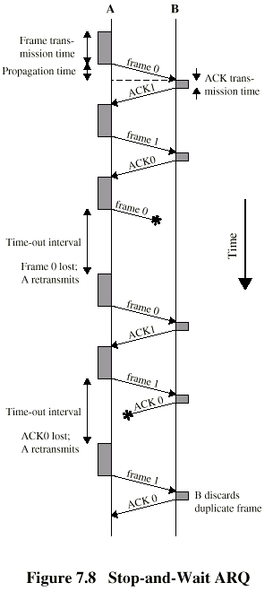
Stop and Wait ARQ illustration
EE4204/TEE4204 (Part 1) Notes 4
G. Mohan/ NUS

Slide 16
Stop and Wait - Pros and Cons
Simple implementation
Poor link utilization
Link utilization (U) is defined as the ratio between the actual time spent for transmitting the given data frames and the total time the link is engaged until the completion of the transfer of the frames
  Numerically equal to throughput rate
EE4204/TEE4204 (Part 1) Notes 4
G. Mohan/ NUS

Slide 17
Go Back N ARQ
Based on sliding window
If no error, receiver sends ACK (or RR) as usual with next frame expected
Use window to control the number of outstanding frames
If error,
  Receiver discards that frame and all future frames until error frame received correctly
  Sender goes back and retransmits that frame and all subsequent frames
EE4204/TEE4204 (Part 1) Notes 4
G. Mohan/ NUS

Slide 18
Go Back N - Damaged Frame
Receiver detects error in frame i
Receiver sends REJ i
  discards any new frame received until frame i is correctly received
Sender gets REJ-i
Sender retransmits frame i and subsequent frames
EE4204/TEE4204 (Part 1) Notes 4
G. Mohan/ NUS

Slide 19
Go Back N - Lost Frame (case 1)
Frame i lost
Sender sends i+1
Receiver gets frame i+1 out of sequence
Receiver sends REJ-i
Sender goes back to frame i and retransmits frame i and subsequent frames
EE4204/TEE4204 (Part 1) Notes 4
G. Mohan/ NUS

Slide 20
Go Back N - Lost Frame (case 2)
Frame i lost and sender does not send additional frames
Receiver gets nothing and returns neither ACK nor REJ
Sender times out and sends RR (command) frame with P (probe) bit set to 1
Receiver interprets this RR as command which it acknowledges with the number of the next frame it expects (RR i )
Sender then retransmits frame i and subsequent frames
EE4204/TEE4204 (Part 1) Notes 4
G. Mohan/ NUS

Slide 21
Go Back N – Damaged/Lost
Acknowledgement
Receiver gets frame i and sends RR (i+1) which is lost
Acknowledgements are cumulative, so next acknowledgement (i+n, n>1) may arrive before sender times out on frame i (case 1)
If sender times out, it sends RR command frame with P bit set as before (case 2)
  This can be repeated a MAX number of times before a reset procedure is initiated
Damaged REJ – similar to LOST frame (case 2)
EE4204/TEE4204 (Part 1) Notes 4
G. Mohan/ NUS

Slide 22
Go Back N Pros and Cons
Better link utilization than stop-and-wait
less complex implementation (compared to selective reject ARQ)
Good choice when errors are rare
Retransmission of error-free frames reduces link utilization
EE4204/TEE4204 (Part 1) Notes 4
G. Mohan/ NUS

Slide 23
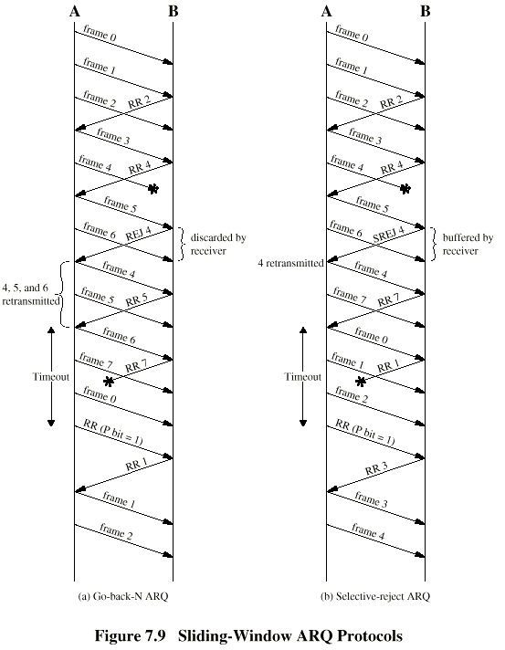
Go Back N
Illustration
EE4204/TEE4204 (Part 1) Notes 4
G. Mohan/ NUS

Slide 24
Selective Reject ARQ
Also called selective retransmission
Only rejected frames are retransmitted
Subsequent frames are accepted by the receiver and buffered
Need to arrange frames in order before delivering to the higher layer
Minimizes retransmission, better link utilization than stop-and-wait and Go-back-N
Unlike Go-back-N, Receiver must maintain large enough buffer
More complex implementation
EE4204/TEE4204 (Part 1) Notes 4
G. Mohan/ NUS

Slide 25
Selective-Reject
Illustration
EE4204/TEE4204 (Part 1) Notes 4
G. Mohan/ NUS

Slide 26
Performance Study
Derive expression for Link Utilization
The following assumptions and notation are made
Frame transmission time T_{f}
Link propagation time T_{p}
Total time that the link is engaged for one frame transmission denoted by T_{total}
Transmission time of ACK frame is negligible
Frame error probability denoted by P_{f}
Errors in ACK frames can be ignored
Errors in retransmitted frames other than the frame initially in error can be ignored(in case of Go-back-N)
EE4204/TEE4204 (Part 1) Notes 4
G. Mohan/ NUS

Slide 27
Parameter a
a = link propagation time (Tp)/frame transmission time (Tf)
a = Number of frames that can be held on a link (how?)
  Related to D×B product of the link where D is Tp
EE4204/TEE4204 (Part 1) Notes 4
G. Mohan/ NUS

Slide 28
Performance of Stop-and-Wait
(error-free and error cases)
P_{f} = 0 (error-free case)
  One frame is transmitted for every T_{f}+2T_{p} time
  T_{total} = T_{f}+2T_{p}
  Link utilization U = T_{f} / T_{total} = 1 / (1+2a)
Pf > 0 (error case)
  Let N_{r} be the expected number of times a frame is transmitted
  N_{r} can be shown to be equal to 1/(1-P_{f}) (How?)
  U = T_{f} /(N_{r}× T_{total}) = (1-P_{f}) / (1+2a)
  T_{f} 2T_{p}
G. Mohan/ NUS
EE4204/TEE4204 (Part 1) Notes 4
G. Mohan/ NUS

Slide 29
Sliding Window Protocol-Error-free Communication
ACK frame is received by the sender after T_{f} + 2T_{p} from the time at which frame transmission starts
Window size WT_{f} ≥ T_{f} + 2T_{p} (W ≥ 1 + 2a)
  Sender receives ACK frame before the window is exhausted; it can send frames continuously; Therefore, U = 1
  Tf+2Tp W=5
  Tp
  T_{f}
Window size WT_{f} <T_{f} + 2T_{p} (W < 1 + 2a)
  Sender sends W frames and waits until T_{f} + 2T_{p} to receive an ACK before sending additional frames; Therefore, U = WT_{f} / (T_{f} + 2T_{p}) = W/(1 + 2a)
  Tf+ 2Tp W=3
  T_{f}
Note: We assume ack is sent for each frame received
G. Mohan/ NUS
EE4204/TEE4204 (Part 1) Notes 4
G. Mohan/ NUS

Slide 30
Sliding Window Protocol ARQ (with errors)
Selective Reject
  U = (1-P_{f}), W ≥ 1 + 2a
  U = [W (1-P_{f})] / (1 + 2a), W < 1 + 2a
Go back N
  U = (1- P_{f}) / (1 + 2aP_{f}), W ≥ 1 + 2a
  U = [W (1-P_{f})] / [(1 + 2a) (1-P_{f}+WP_{f})], W < 1 + 2a
For proof, refer “Data and Computer Communications” by William Stallings and/or other reference books
EE4204/TEE4204 (Part 1) Notes 4
G. Mohan/ NUS

